Slide 1


Supporting carers in the workplace:
Key stats

Slide 2
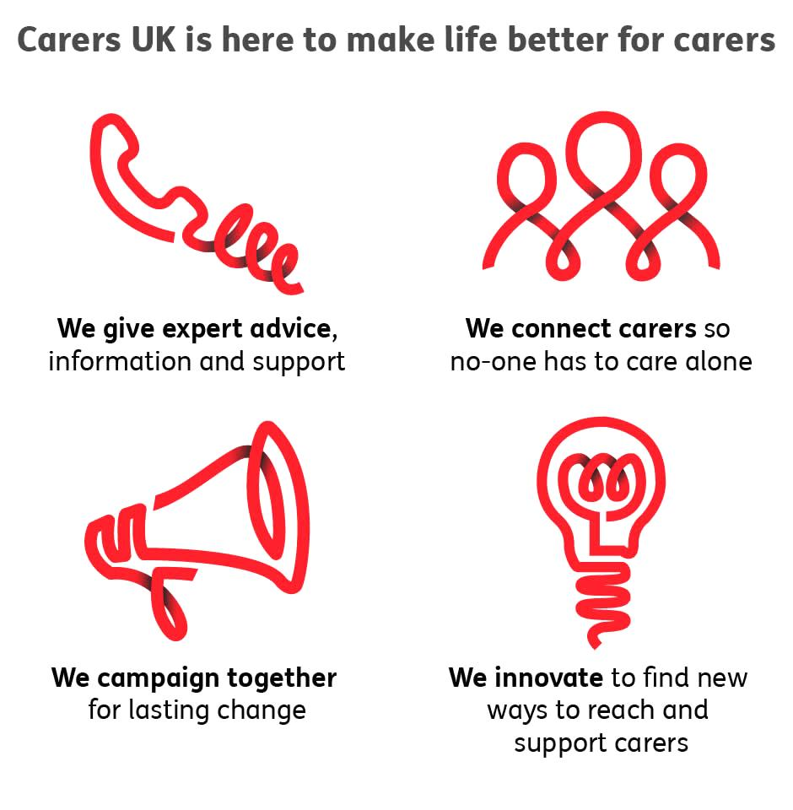
Notes:
A bit about Carers UK

Slide 3

Every day over 12,000 people become carers
Carers look after loved ones who are older, disabled or seriously ill.
Caring can affect anyone, at any age, at any time and can last a lifetime.
Carers UK aims to make sure no one has to care alone.
Key stats

Slide 4
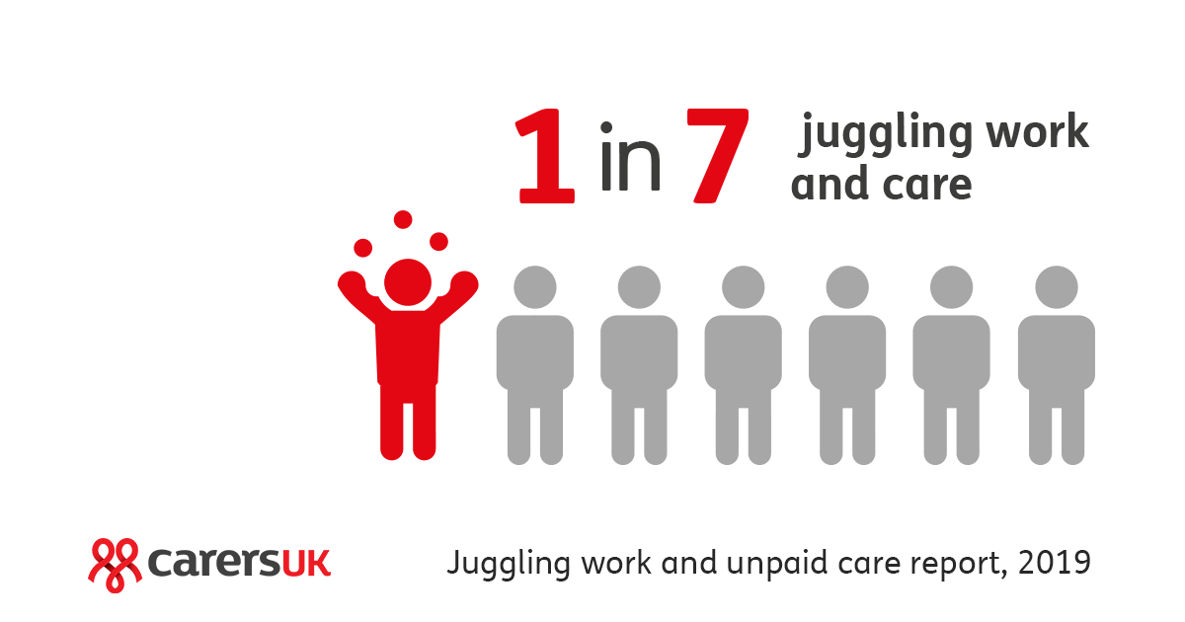
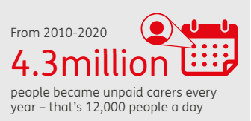
Who are carers?
Carers look after loved ones who are older, disabled or ill
Caring can affect anyone, at any age, at any time
Every day 12,000 people in the UK become carers
It takes an average of two years to self-identify as a carer
Key stats
Notes:
Carers UK research in 2019 found that there could be around 4.87 million people juggling work and care in the UK: 1 in 7 of all workers.
Every day 12,000 people in the UK become carers
Carers look after loved ones who are older, disabled or ill
Caring can affect anyone, at any age, at any time
It takes an average of two years to self-identify as a carer
Very few carers will know where to get information and support

Slide 5
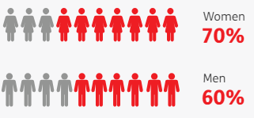
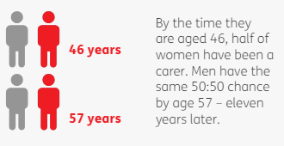
How likely are we to become carers?
Two thirds of adults are expected to care in their lifetime
Women have a 50:50 chance of caring by age 46
Men have a 50:50 chance of caring by age 57
Key stats
Notes:
Two thirds of adults are expected to care unpaid for a family member or friend in their lifetime
Women have a 50:50 chance of caring by the time they are age 46; men have the same chance by the time they are 57 – 11 years later
More women than men also provide high intensity care at ages when they would expect to be in paid work

Slide 6
Caring and employment
According to the Census 2021, there are 2.5 million unpaid carers in employment (excluding full-time students) in England and Wales: 9% of the workforce.
Every year, more than 1.9 million people in paid employment become unpaid carers, some overnight, some more gradually – over 5,000 people every day.
People providing unpaid care are more likely than those without caring responsibilities to be working part time. The Census 2021 in England and Wales found that 38% of carers in employment are working part time compared with 29% of non-carers in employment.
Key stats

Slide 7
State of Caring 2024 – The impact of caring on employment
The survey found that:
73% of carers in employment said they had found it stressful to juggle work and care.
44% of carers in employment said they had reduced their working hours to care
A quarter (25%) of carers in employment had to take on a lower paid or more junior role.
Key stats

Slide 8
Business Benefits of supporting carers
Improved recruitment and retention
Reduced costs
Centrica estimates potential costs savings of £2.5m through increased staff retention and £4.5m through reduced unplanned absenteeism
Improved resilience and results
Reduced stress and absenteeism
BT achieved a productivity increase of 21% a year, at least £5 million on the bottom line
Key stats

Slide 9
Contact:
www.employersforcarers.org
client.services@carersuk.org
www.carersuk.org
info@carersuk.org

